Slide 1


Slide 2
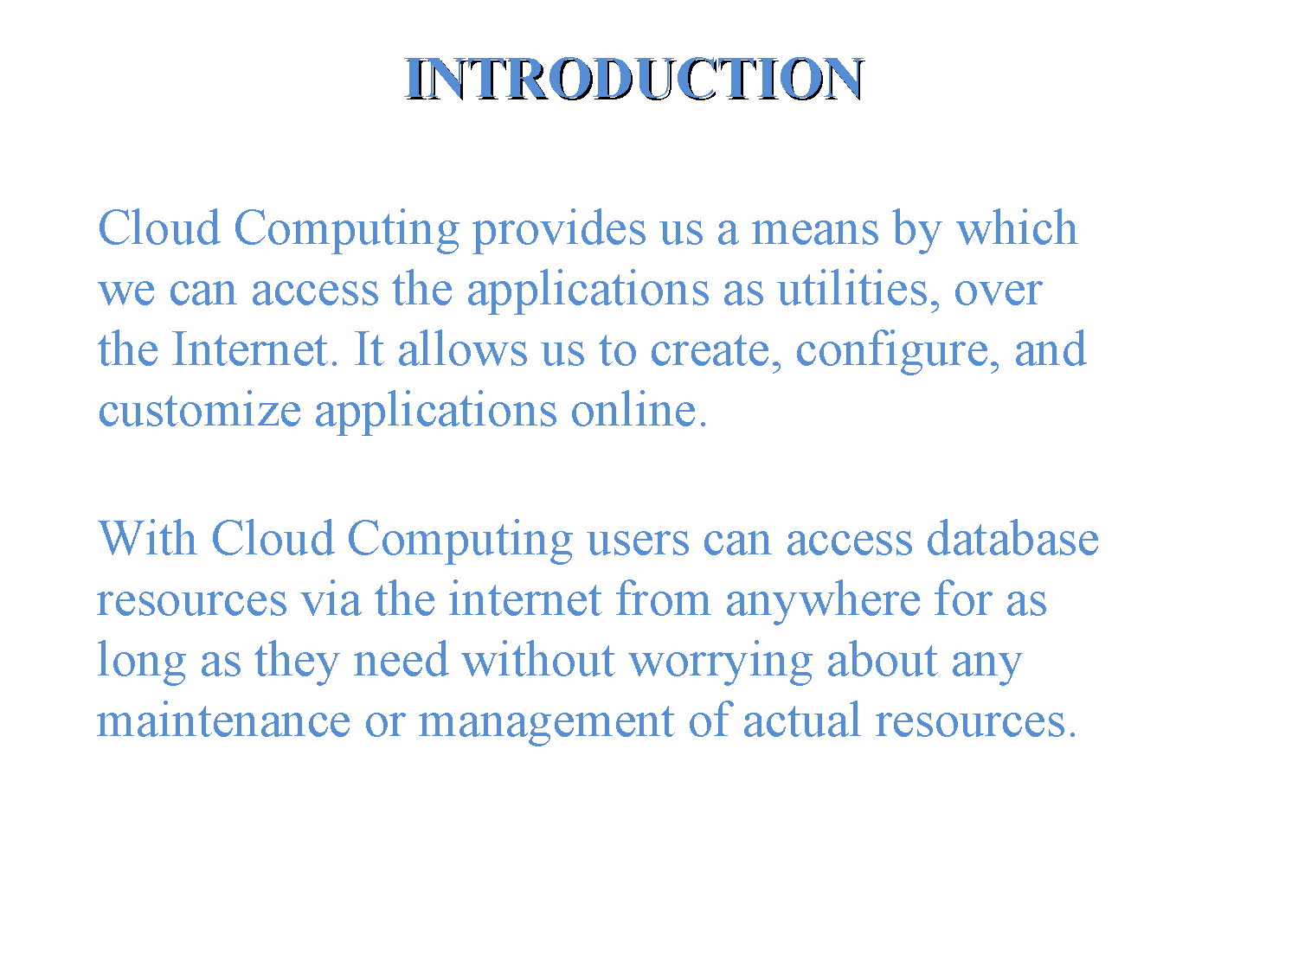

Slide 3
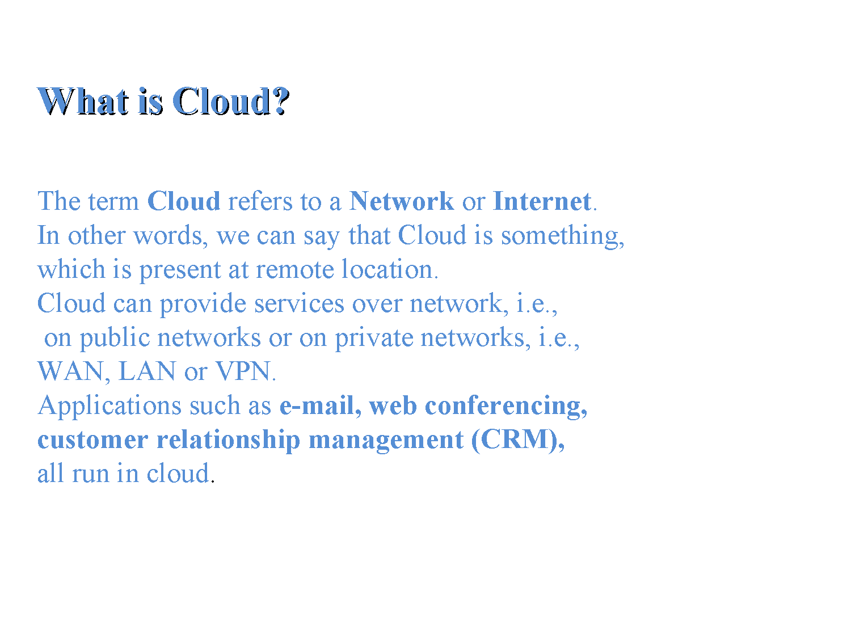

Slide 4
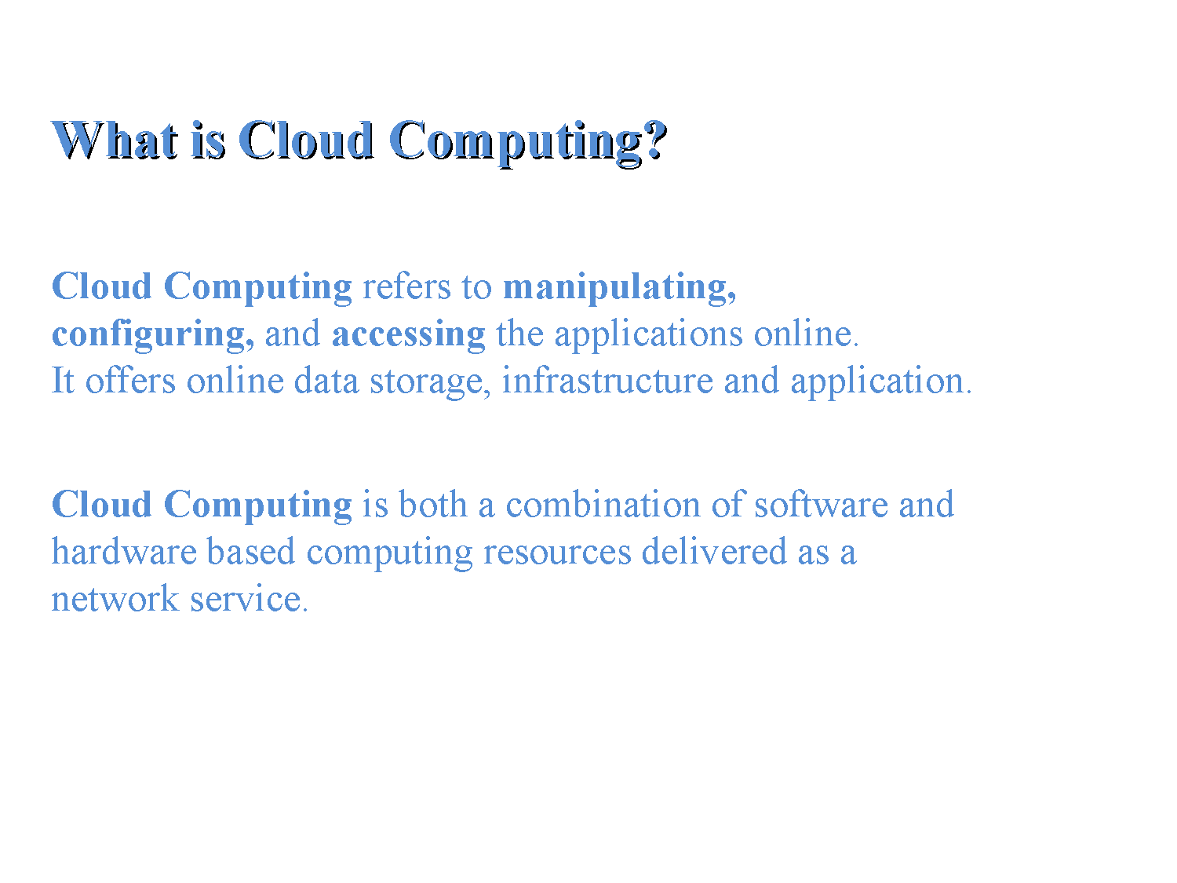

Slide 5
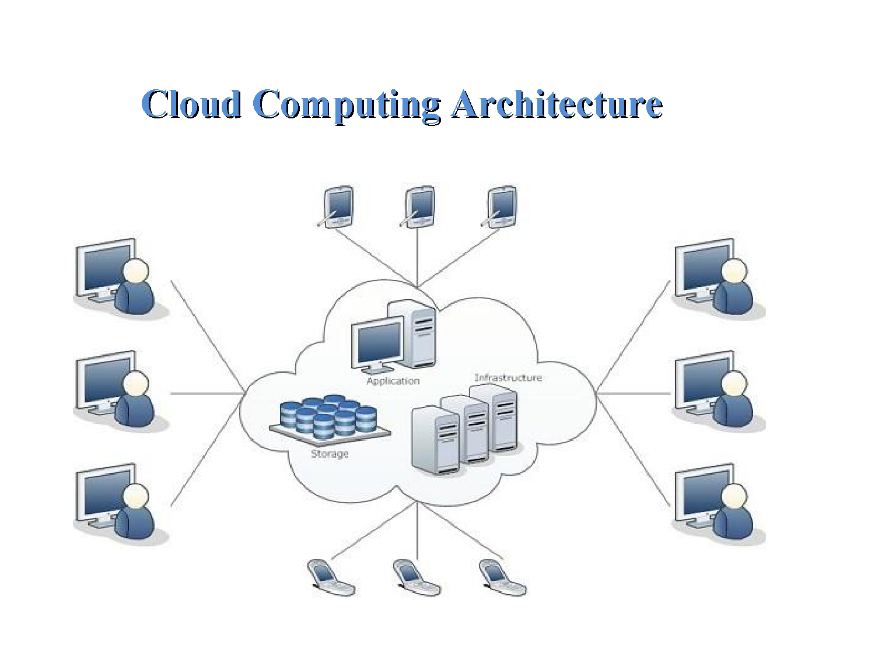

Slide 6
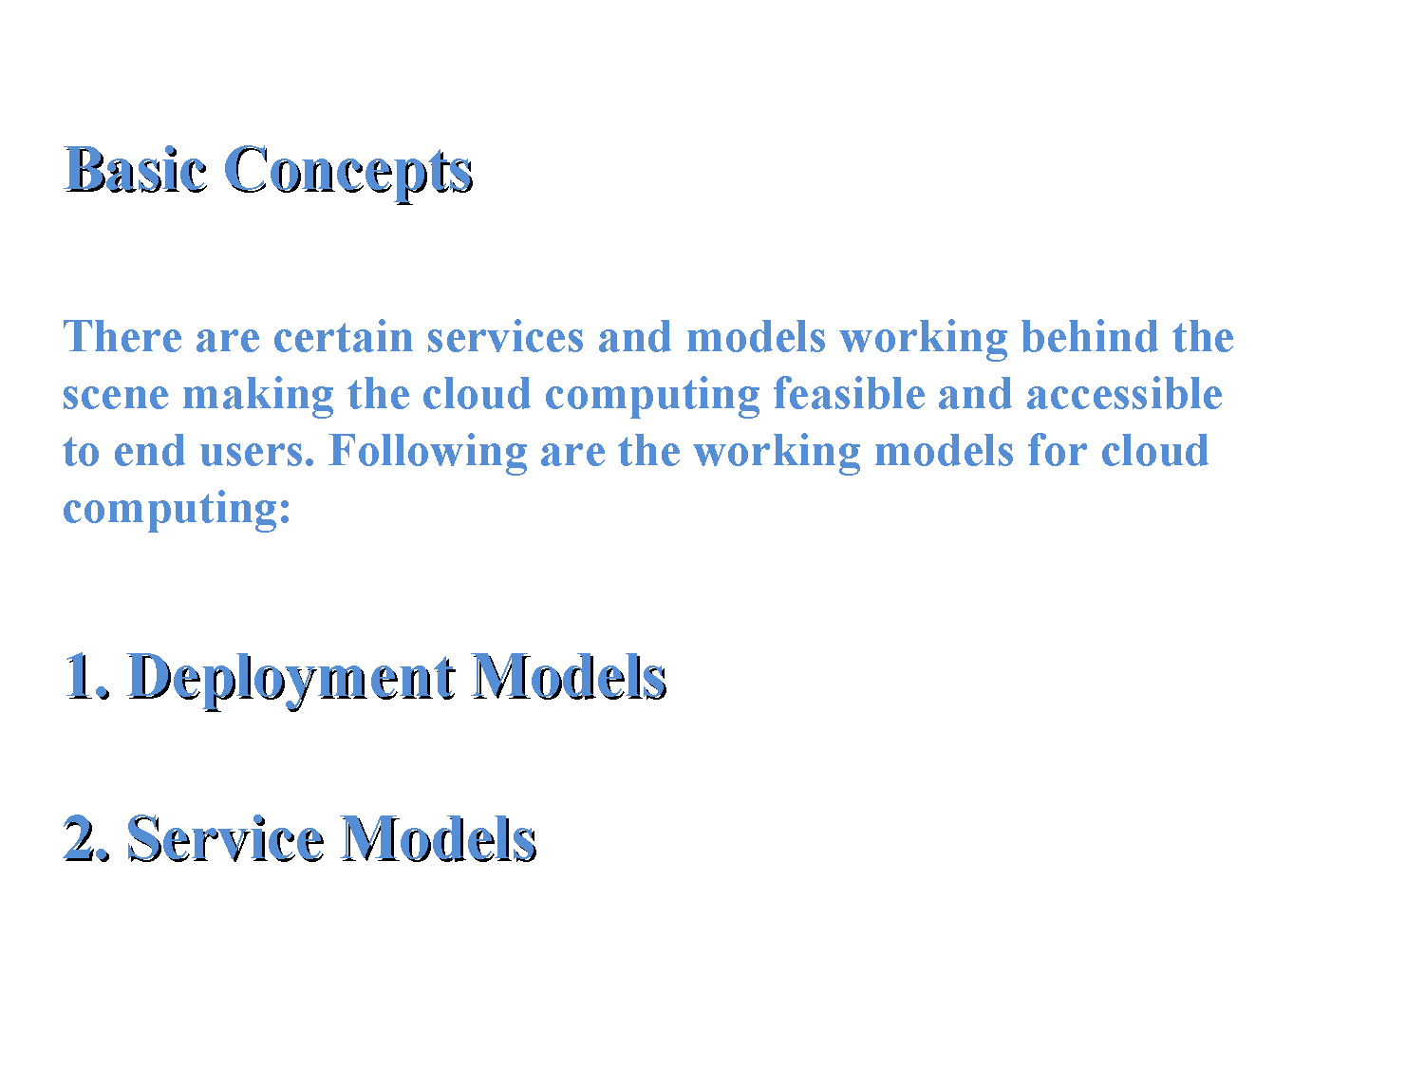

Slide 7
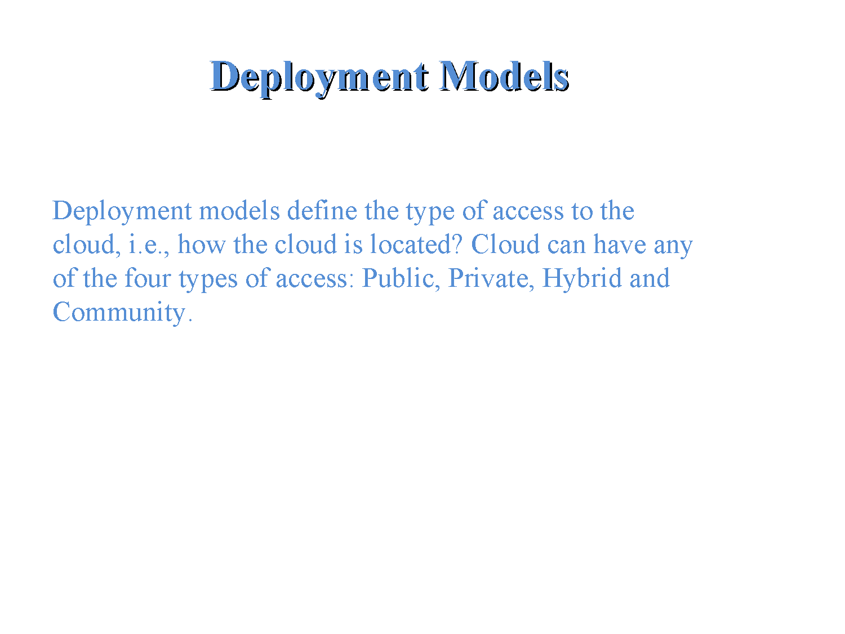

Slide 8
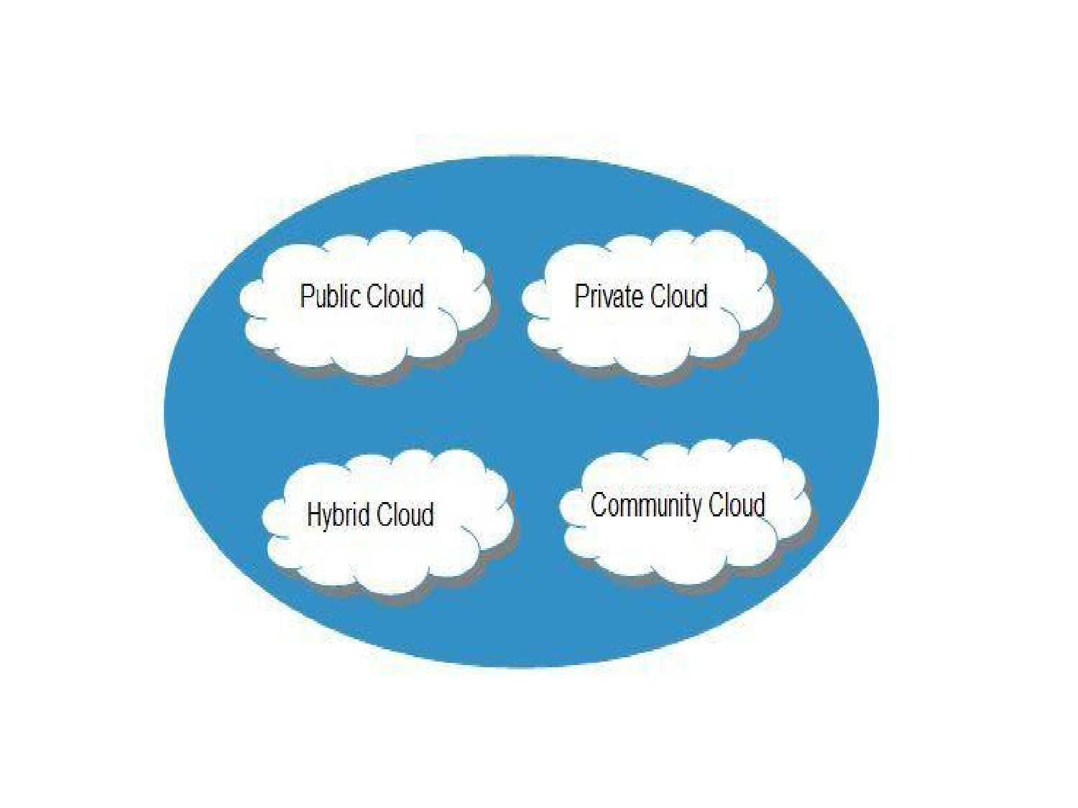

Slide 9
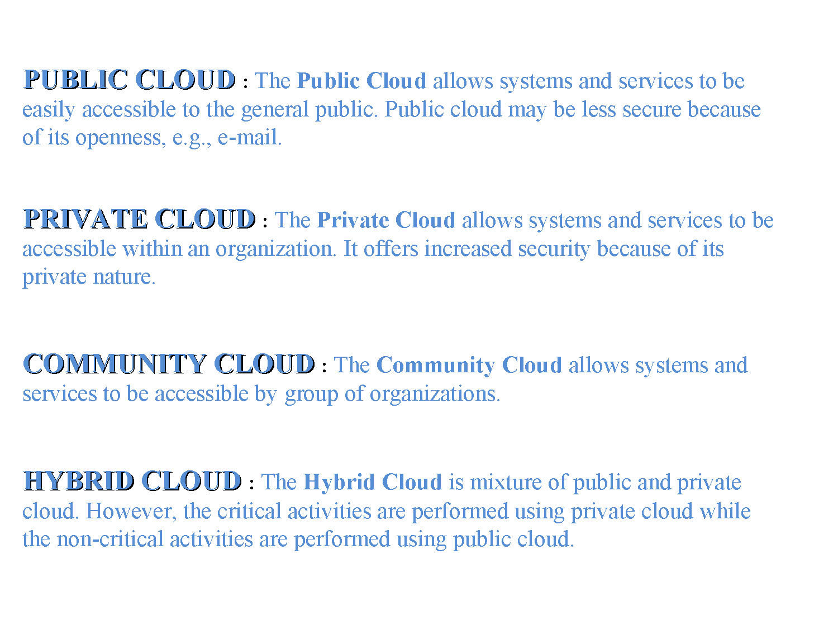

Slide 10
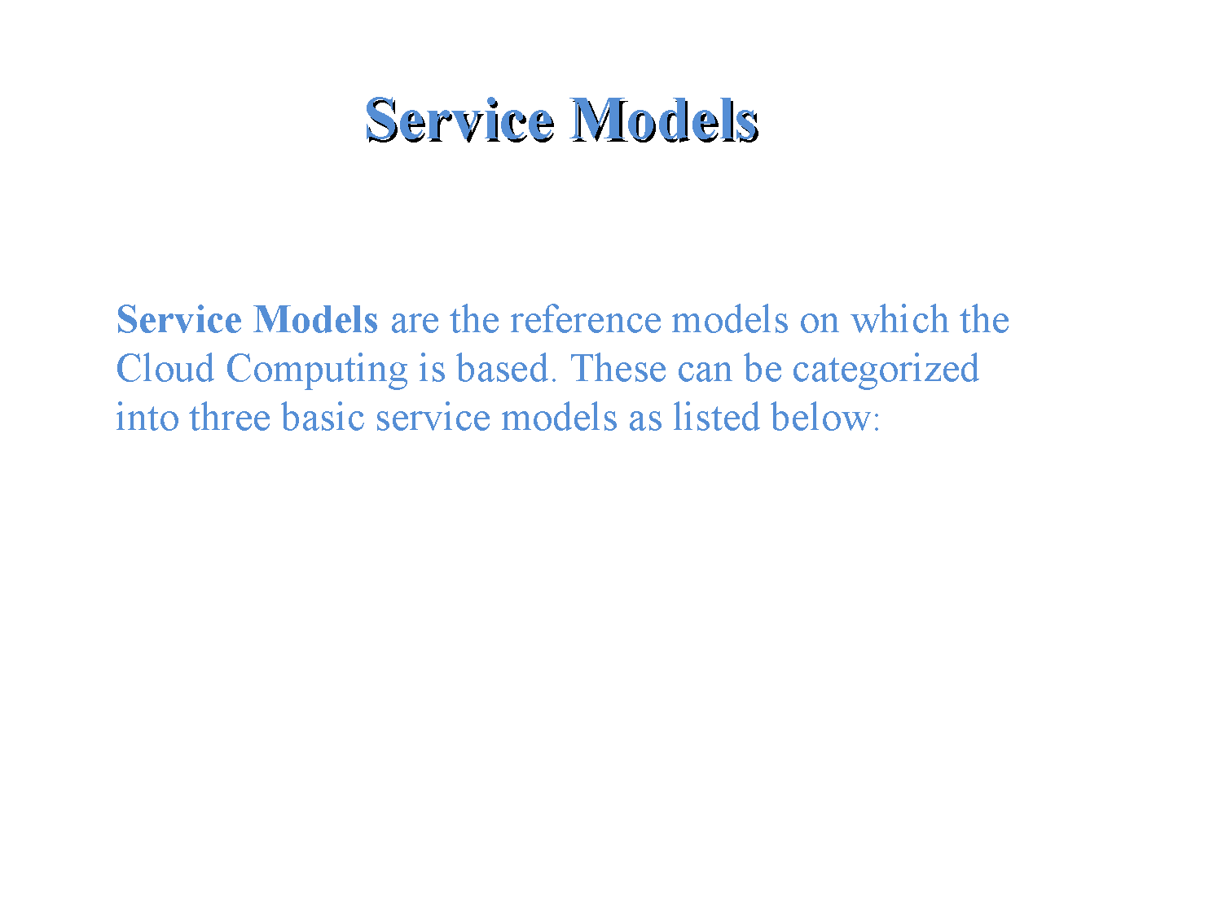

Slide 11
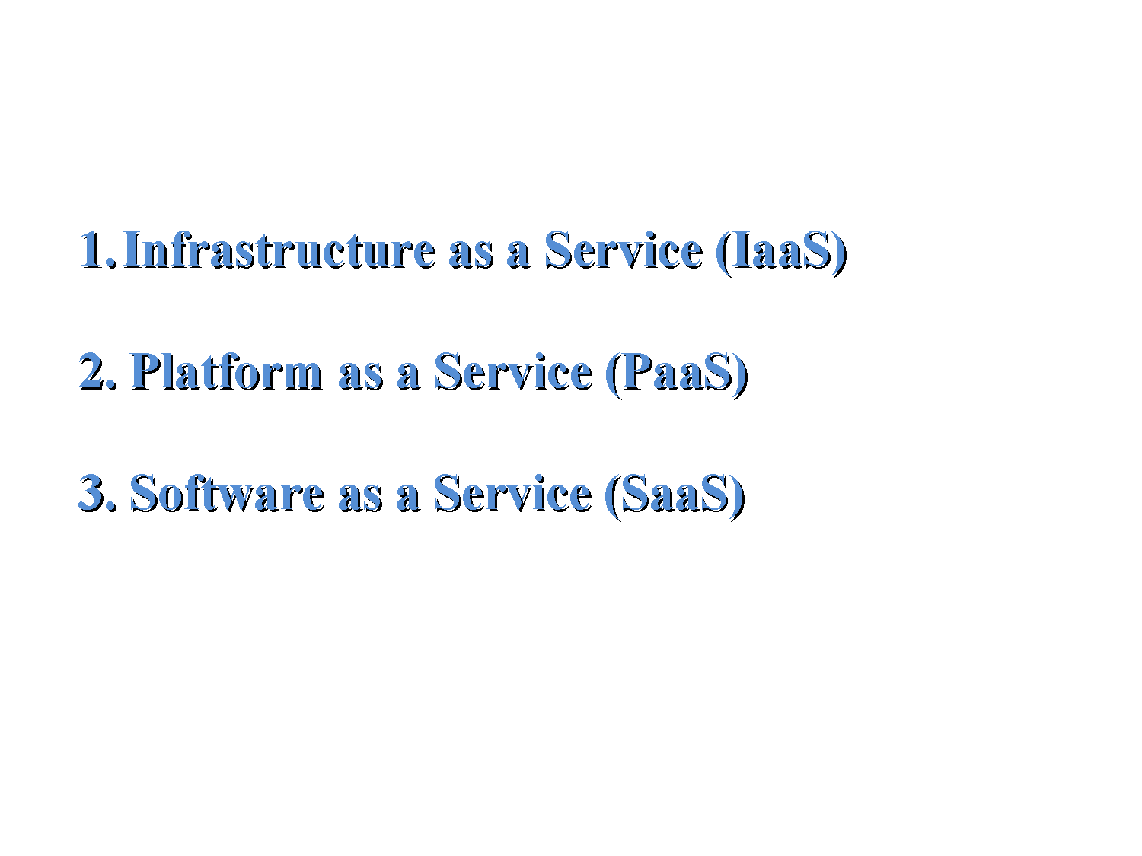

Slide 12
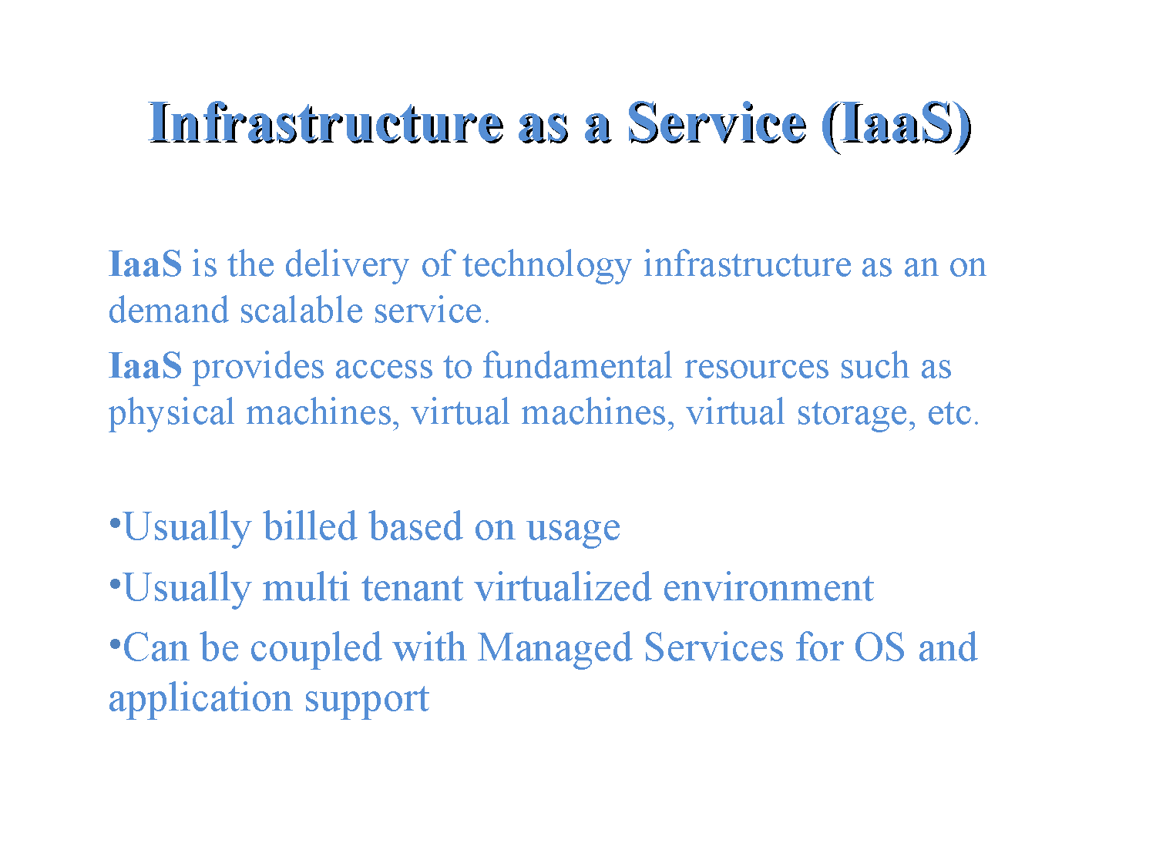

Slide 13
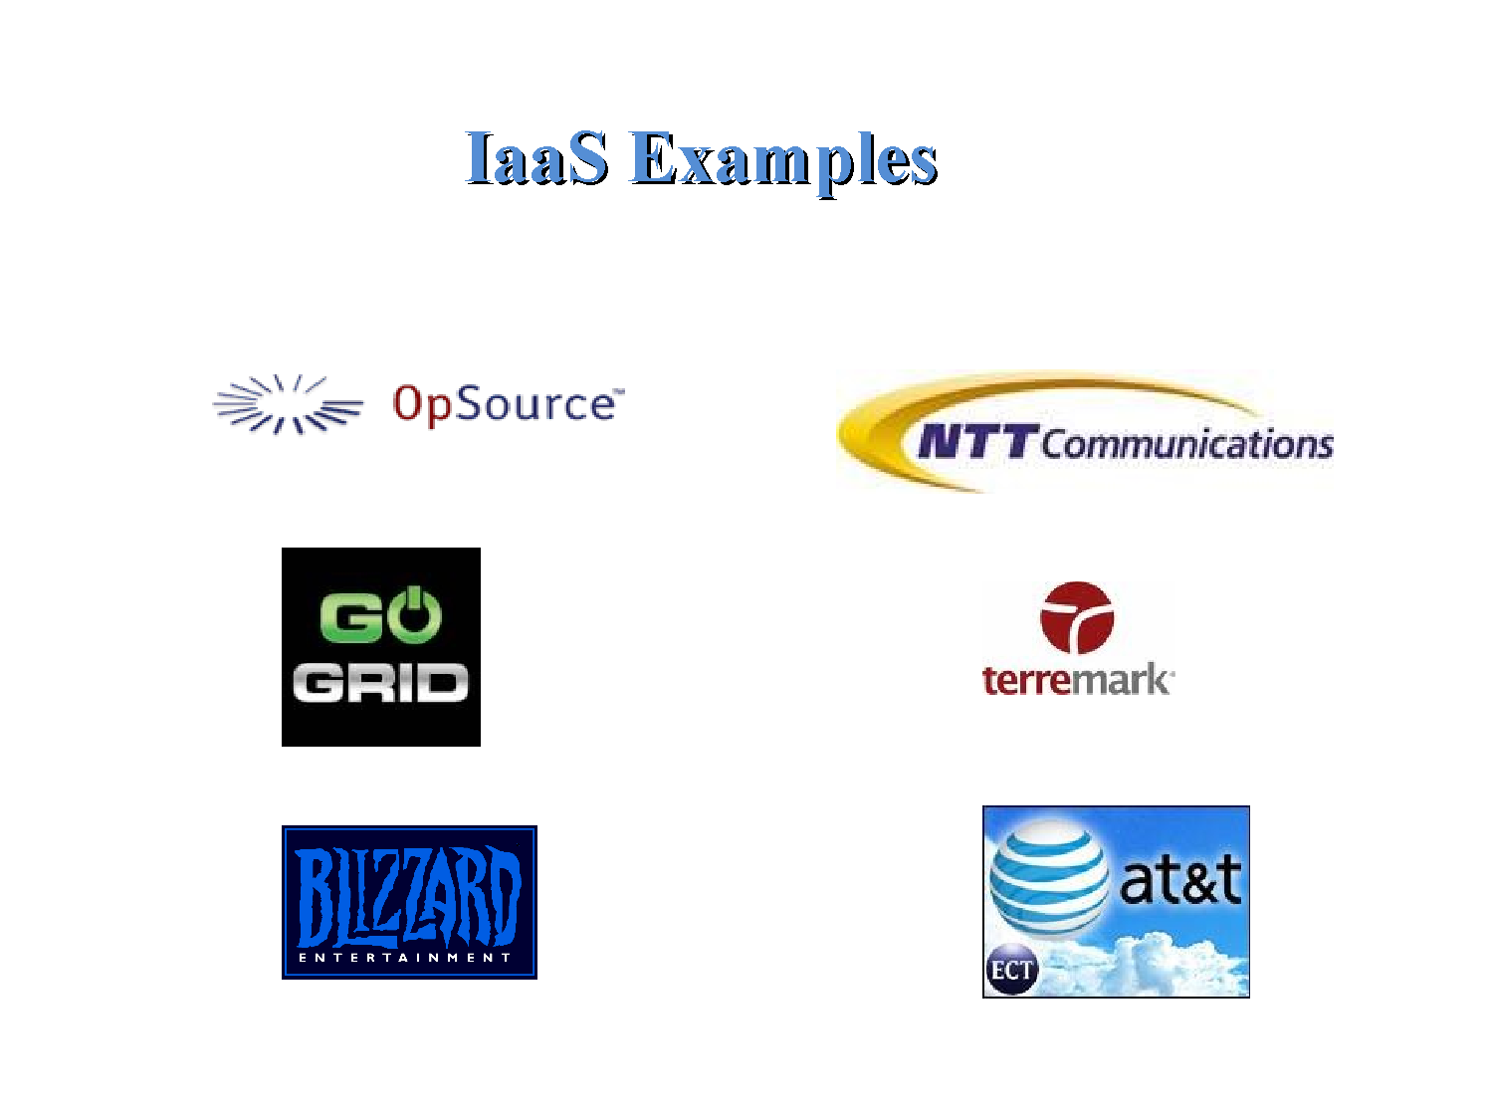

Slide 14
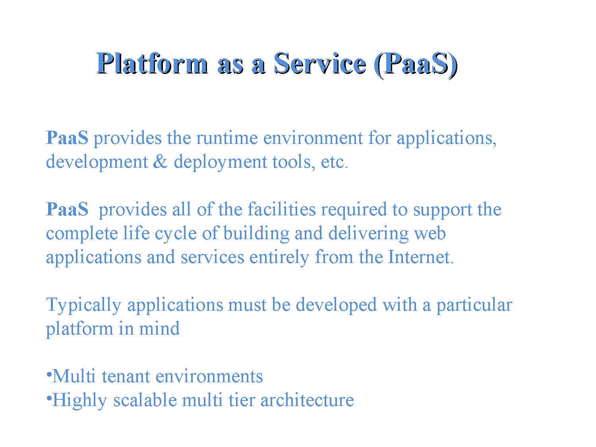

Slide 15
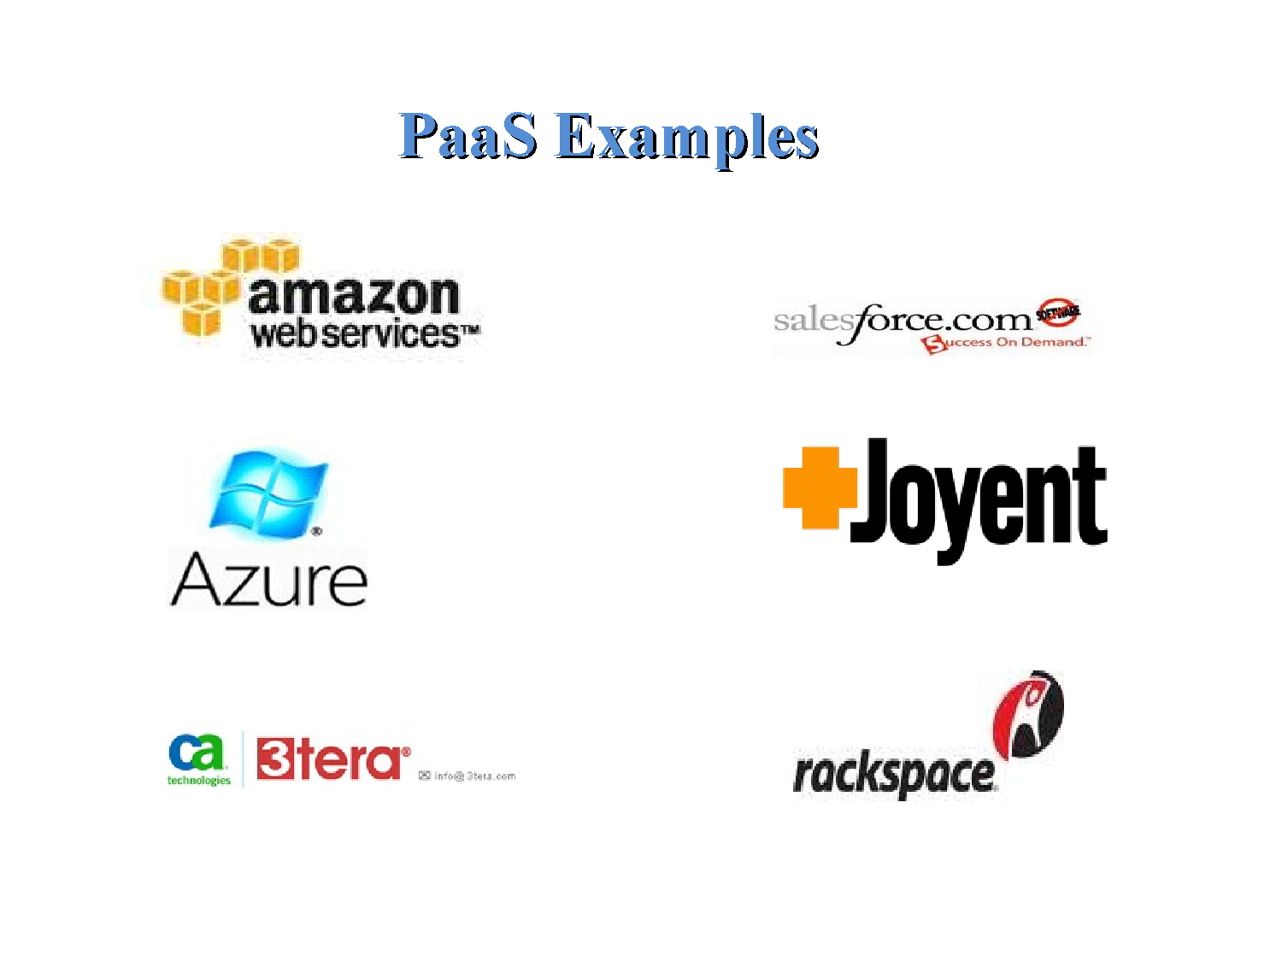

Slide 16
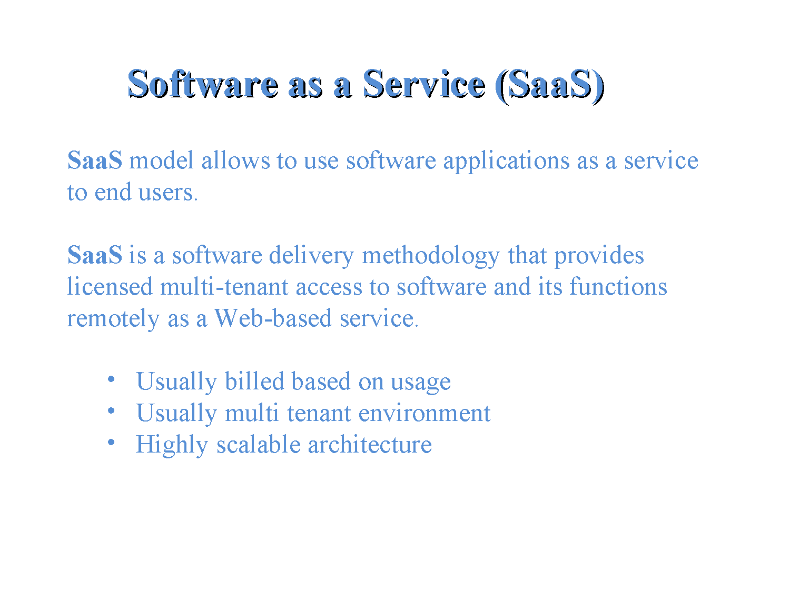

Slide 17
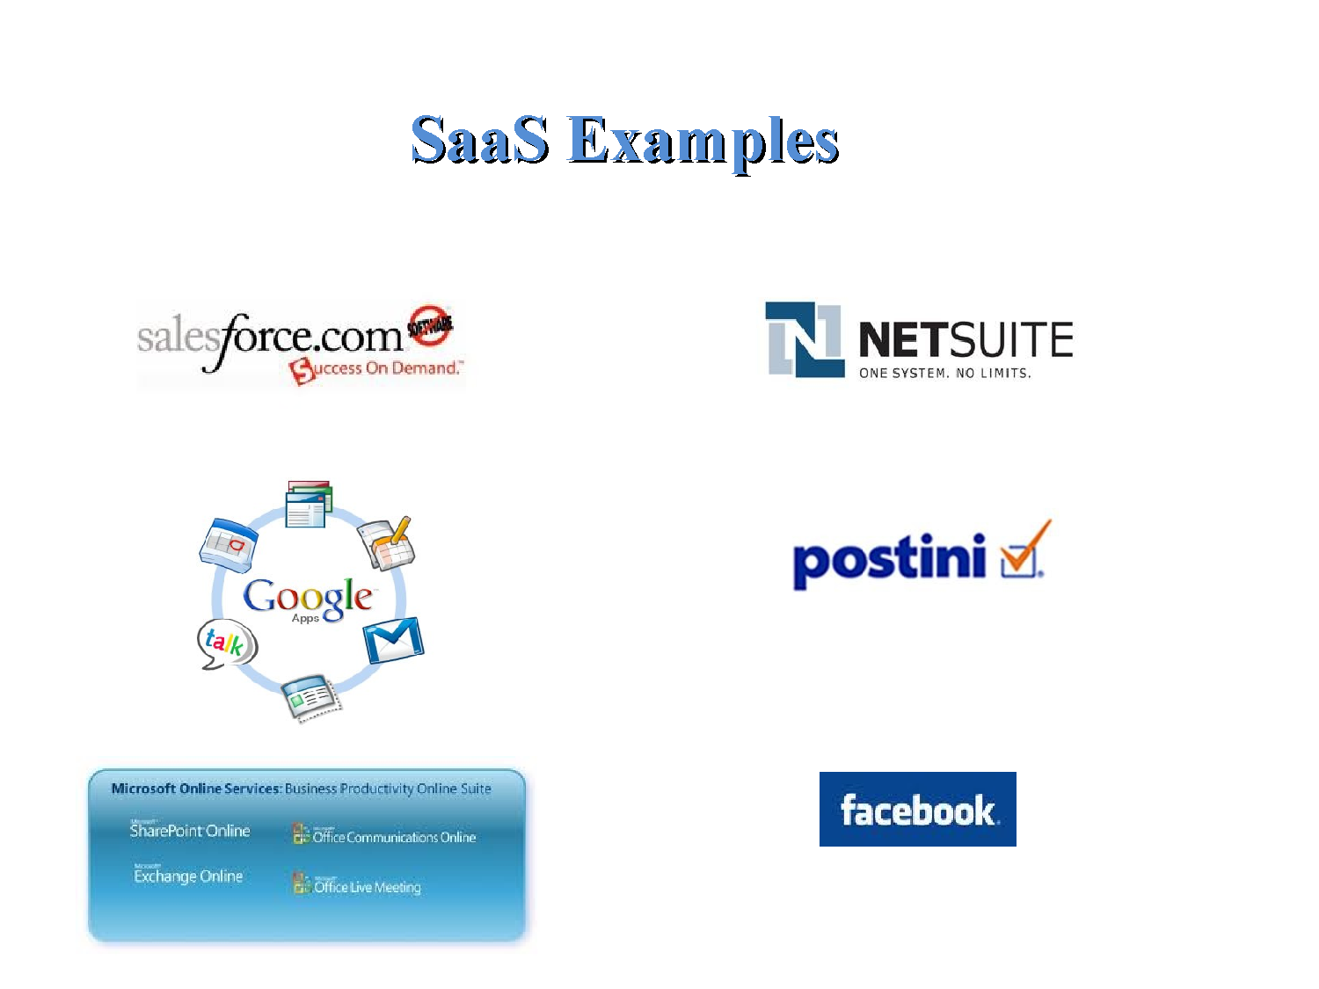

Slide 18
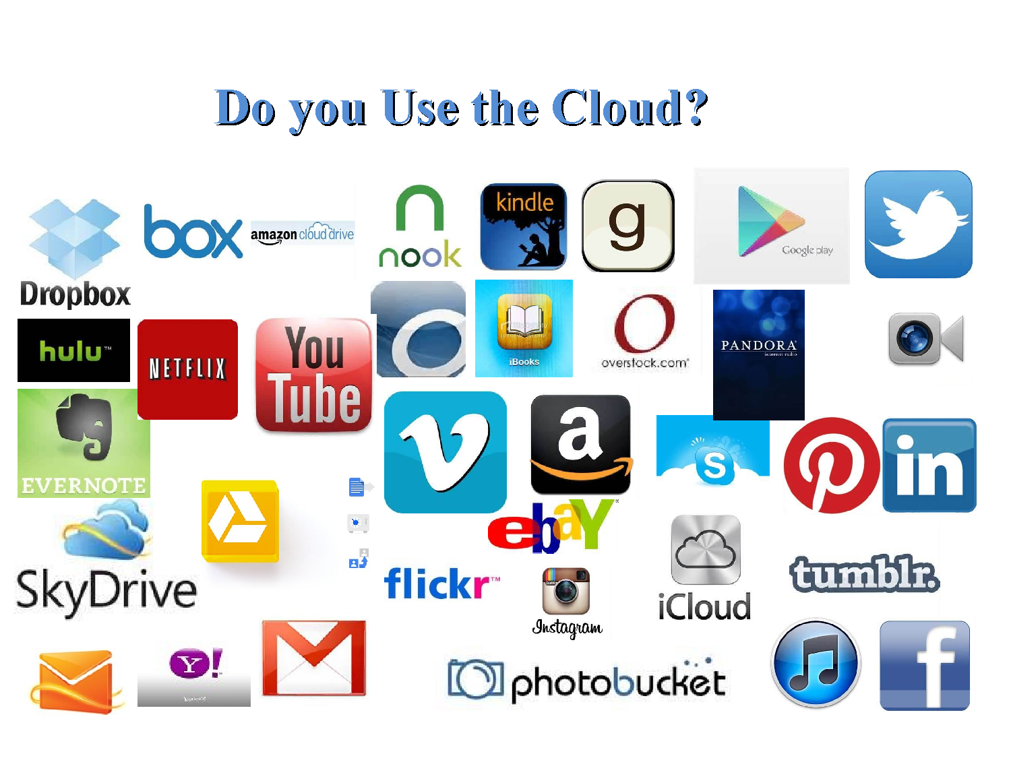

Slide 19
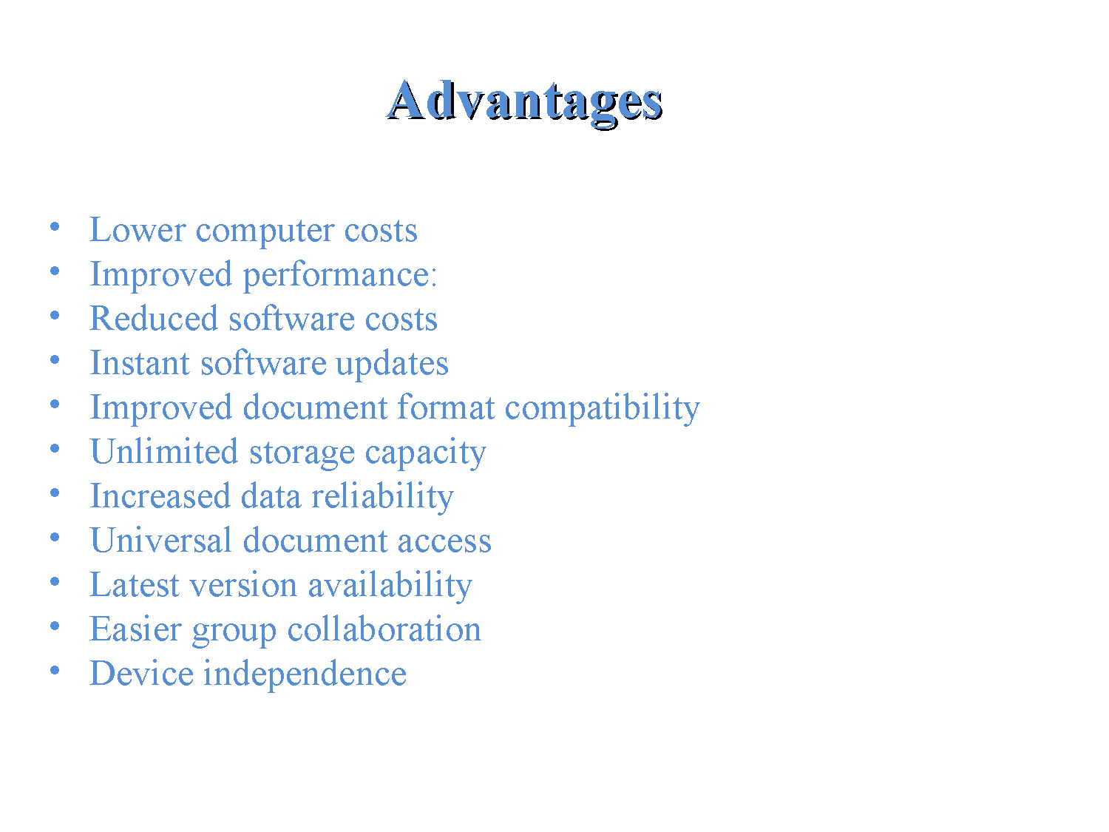

Slide 20
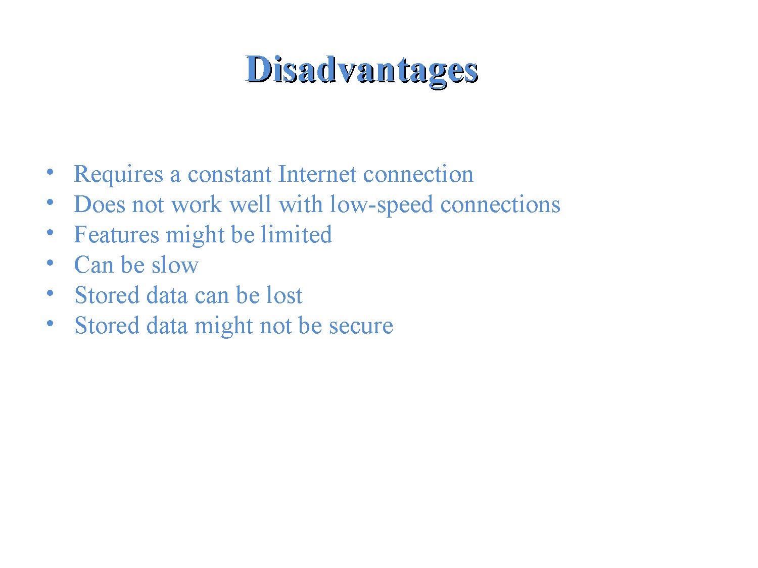

Slide 21


Slide 22

AWS is Amazon’s umbrella description of all of their web-based technology services.
Mainly infrastructure services:
  Amazon Elastic Compute Cloud (EC2)
  Amazon Simple Storage Service (S3)
  Amazon Simple Queue Service (SQS)
  Amazon CloudFront
  Amazon SimpleDB

Slide 23

Amazon Elastic Compute Cloud (Amazon EC2) provides scalable computing capacity in the Amazon Web Services (AWS) cloud.
Using Amazon EC2 eliminates your need to invest in hardware up front, so you
can develop and deploy applications faster.
You can use Amazon EC2 to launch as many or as few virtual
servers as you need, configure security and networking, and manage storage.

Slide 24

Amazon EC2 enables you
to scale up or down to handle changes in requirements or spikes in popularity, reducing your need to
forecast traffic.

Slide 25

Virtual computing environments, known as instances.
Preconfigured templates for your instances, known as Amazon Machine Images (AMIs), that package
the bits you need for your server (including the operating system and additional software)
Various configurations of CPU, memory, storage, and networking capacity for your instances, known as
instance types

Slide 26
Secure login information for your instances using key pairs (AWS stores the public key, and you store
the private key in a secure place).
Storage volumes for temporary data that's deleted when you stop or terminate your instance, known as instance store volumes.
Persistent storage volumes for your data using Amazon Elastic Block Store (Amazon EBS), known as
Amazon EBS volumes

Slide 27

If you've already signed up for Amazon Web Services (AWS), you can start using Amazon EC2 immediately. You can open the Amazon EC2 console,
choose Launch Instance, and follow the steps in the launch wizard to launch your first instance.

Slide 28

Amazon Relational Database Service (Amazon RDS) is a web service that makes it easier to set up,operate, and scale a relational database in the cloud.
It provides cost-efficient, resizable capacity for an industry-standard relational database and manages common database administration tasks.

Slide 29

When you buy a server, you get CPU, memory, storage, and IOPS, all bundled together. With Amazon RDS, these are split apart so that you can scale them independently. If you need more CPU, less IOPS, or more storage, you can easily allocate them.
Amazon RDS manages backups, software patching, automatic failure detection, and recovery.

Slide 30
To deliver a managed service experience, Amazon RDS doesn't provide shell access to DB instances, and it restricts access to certain system procedures and tables that require advanced privileges.
You can use the database products you are already familiar with: MySQL, MariaDB, PostgreSQL, Oracle,
Microsoft SQL Server.

Slide 31
In addition to the security in your database package, you can help control who can access your RDS databases by using AWS Identity and Access Management (IAM) to define users and permissions.
Youcan also help protect your databases by putting them in a virtual private cloud.

Slide 32

The basic building block of Amazon RDS is the DB instance.
A DB instance is an isolated database
environment in the cloud.
A DB instance can contain multiple user-created databases, and you can access it by using the same tools and applications that you use with a stand-alone database instance

Slide 33
You can create and modify a DB instance by using the AWS Command Line Interface, the Amazon RDS API, or the AWS Management Console.
Each DB instance runs a DB engine. Amazon RDS currently supports the MySQL, MariaDB, PostgreSQL, Oracle, and Microsoft SQL Server DB engines.

Slide 34

Amazon Simple Storage Service is storage for the Internet.
It is designed to make web-scale computing
easier for developers.
Amazon S3 has a simple web services interface that you can use to store and retrieve any amount of data, at any time, from anywhere on the web.
It gives any developer access to the same highly scalable, reliable, fast, inexpensive data storage infrastructure that Amazon uses to run its own global network of web sites.

Slide 35

Create Buckets – Create and name a bucket that stores data. Buckets are the fundamental container in Amazon S3 for data storage.
Store data in Buckets – Store an infinite amount of data in a bucket. Upload as many objects as you like into an Amazon S3 bucket. Each object can contain up to 5 TB of data. Each object is stored and retrieved using a unique developer-assigned key.

Slide 36
Download data – Download your data or enable others to do so. Download your data any time you like or allow others to do the same.
Permissions – Grant or deny access to others who want to upload or download data into your Amazon S3 bucket. Grant upload and download permissions to three types of users. Authentication mechanisms can help keep data secure from unauthorized access.

Slide 37

AWS Command Line Interface
The AWS CLI is an open source tool that enables you to interact with AWS services using commands in your command-line shell. With minimal configuration.
you can start using functionality equivalent to that provided by the browser-based AWS Management Console from the command prompt in your favorite terminal program.

Slide 38
Linux shell
Window shell
The AWS CLI provides direct access to AWS services' public APIs. You can explore a service's capabilities with the AWS CLI, and develop shell scripts to manage your resources. Or, you can take what you learn to develop programs in other languages with the AWS SDKs.

